Slide 1


Dependency Injection
Nemanja Đorđević
Ivan Lazarević

Slide 2


What is DI?
Wikipedia
Dependency injection is a software design pattern that allows a choice of component to be made at run-time rather than compile time.
2012
Dependency injection is a software design pattern that allows the removal of hard-coded dependencies and makes it possible to change them, whether at run-time or compile-time.
2013
In software engineering, dependency injection is a technique whereby one object supplies the dependencies of another object.
2017

Slide 3
What is DI?
Dependency Injection is a set of software design principles and patterns that enable us to develop loosely coupled code.
Mark Seemann. Dependency Injection in .NET.Manning, 2012.

Slide 4
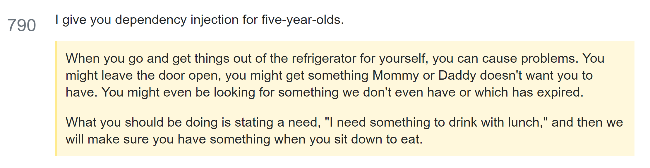
What is DI?
☺ How to explain dependency injection to a 5-year-old?
http://stackoverflow.com/questions/1638919/how-to-explain-dependency-injection-to-a-5-year-old

Slide 5
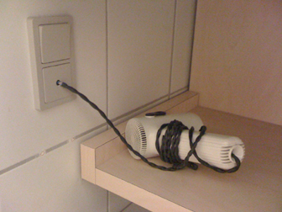



Understanding the purpose of DI
LISKOV SUBSTITUTION
PRINCIPLE
Cheap hotel
Decorator Pattern
UPS

Slide 6
DEMO: Hello DI - simple console app example

Slide 7
Relationship between the collaborators

Slide 8
Application Layering
We have layers, so we have loose coupling.
View
Presentation
Repository
Let’s look at the code!
Service

Slide 9
View – ViewModel Relationship
public partial class SuperheroesViewerWindow : Window
{
public SuperheroesViewerWindow()
{
InitializeComponent();
DataContext = new SuperheroViewModel();
}
}
The View is responsible for creating and managing the ViewModel

Slide 10
ViewModel – Repository Relationship
public class SuperheroViewModel : INotifyPropertyChanged
{
protected SuperheroRepository _repository;
public SuperheroViewModel()
{
_repository = new SuperheroRepository();
}
...
}
The ViewModel references a concrete type of Repository
The ViewModel is responsible for creating and managing the Repository

Slide 11
Repository –Service Relationship
public class SuperheroRepository
{
SuperheroServiceClient _serviceProxy = new SuperheroServiceClient();
...
}
The Repository references a concrete type of Service
The Repository is responsible for creating and managing the Service

Slide 12

Tight Coupling
View
Presentation
Repository
Service

Slide 13
Scenario: Different Repositories
public class SuperheroViewModel : INotifyPropertyChanged
{
protected ISuperheroRepository _repository;
public SuperheroViewModel()
{
var repositoryType = ConfigurationManager.AppSettings[“RepositoryType”];
switch(repositoryType)
{
case “Service” : _repository = new SuperheroRepositoryService();
break;
case “SQL” : _repository = new SuperheroRepositorySQL();
break;
case “CSV” : _repository = new SuperheroRepositoryCSV();
break;
}
}
...
}

Slide 14
Scenario: Unit Testing
To test the ViewModel:
Create instance of SuperheroRepository
Create instance of SuperheroServiceClient
WCF must be running in order for test to run
Do we want Unit Test or Integration Test?

Slide 15
Lab excercise: Tight Coupling to Loose Coupling

Slide 16
Composing the Application
Bootstrapper (Application)
View
Presentation
Repository
Service

Slide 17
DEMO: Add Bootstraper app, Add different Repository, Add Caching repository

Slide 18
Composition Root
Where should we compose object graphs?
As close as possible to the application's entry point.
A Composition Root is a (preferably) unique location in an application where modules are composed together.
Only applications should have Composition Roots. Libraries and frameworks shouldn't.
A DI Container should only be referenced from the Composition Root. All other modules should have no reference to the container.

Slide 19
The appropriate entry point
In console applications it's the Main method
In ASP.NET MVC applications it's global.asax and a custom IControllerFactory
In WPF applications it's the Application.OnStartup method
In WCF it's a custom ServiceHostFactory
In ASP.NET Core it’s the ConfigureServices method in Startup class

Slide 20
Benefits of DI
Benefit | Description | When is it valuable?
Late binding | Services can be swapped with other services. | Valuable in standard software, but perhaps less so in enterprise applications where the runtime environment tends to be well-defined
Extensibility | Code can be extended and reused in ways not explicitly planned for. | Always valuable
Parallel development | Code can be developed in parallel. | Valuable in large, complex applications; not so much in small, simple applications
Maintainability | Classes with clearly defined responsibilities are easier to maintain. | Always valuable
TESTABILITY | Classes can be unit tested. | Only valuable if you unit test

Slide 21
What to inject and what not to inject?
Seams – a SEAM is a place where an application is assembled from its constituent parts, similar to the way to the way a piece of clothing is sewn together at its seams.
Program
Salutation
SEAM
ConsoleMessageWritter

Slide 22
What to inject and what not to inject?
Stable Dependencies (e. g. BCL types)
The class or module already exists.
You expect that new versions won’t contain breaking changes.
The types in question contain deterministic algorithms.
You never expect to have to replace the class or module with another.
Volatile Dependencies
introduces a requirement to set up and configure a runtime environment for the application. (e.g. relational DB
doesn’t yet exist, but is still in development.
isn’t installed on all machines in the development organization
contains nondeterministic behavior

Slide 23
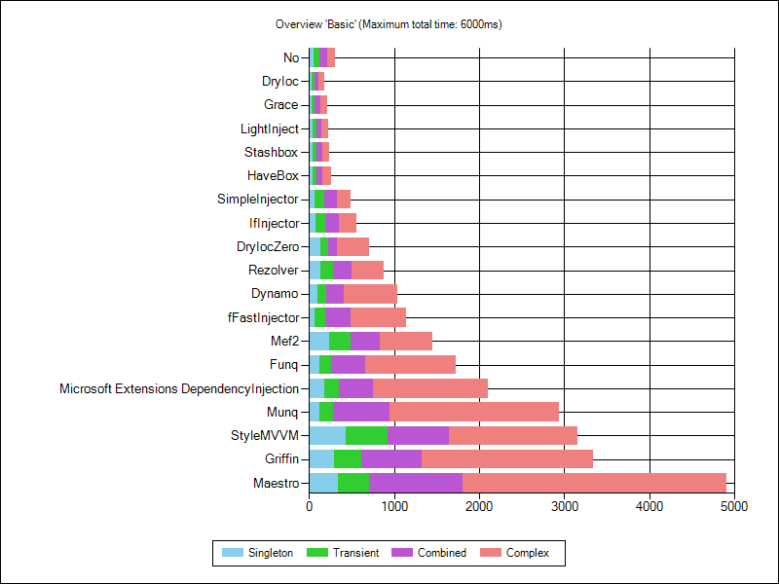
DI Containers
Which one to use?
https://github.com/danielpalme/IocPerformance

Slide 24
DI Containers
Code as configuration
File configuration (XML/JSON)
AUTO-REGISTRATION
var dataAccess = Assemlby.GetExecutingAssembly();
builder.RegisterAssemblyTypes(dataAccess)
.Where(t => t.Name.EndsWith(”Repository”))
.AsImplementedInterfaces();

Slide 25
Lab excercise: Add DI Container which reads configuration from file

Slide 26
DI Patterns
Constructor injection
guarantee that a necessary Dependency is always available
It clearly documents that the class requires the DEPENDENCIES it requests through its constructor
constrain the design to a single constructor. Overloaded constructors lead to ambiguity: which constructor should a DI CONTAINER use?

Slide 27
DI Patterns
Property injection
enable DI as an option in a class when we have a good Local Default
class must expose a public writable property of the DEPENDENCY’s type
switch the DEPENDENCY in the middle of the class’s lifetime!
best used when the DEPENDENCY is optional
only one among many different ways of applying the OPEN/CLOSED PRINCIPLE

Slide 28
DI Patterns
Method injection
When a DEPENDENCY can vary with each method call, you can supply it via a method parameter.
Client
Creates
SomeClass
DoStuff(ISomeInterface)
Invokes with
ISomeInterface
when the caller wishes to provide the consumer with information about the context in which the operation is being invoked

Slide 29
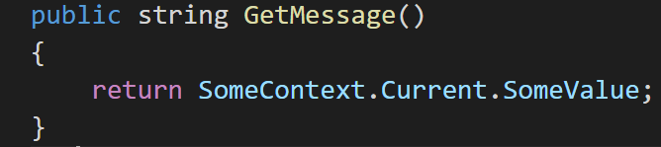
DI Patterns
Ambient context
make a Dependency available to every module without polluting every API with Cross-Cutting Concerns - VIA A STATIC ACCESSOR
the context itself must be an ABSTRACTION and it must be possible to modify the context from the outside
AMBIENT CONTEXT only provides an instance of a single, strongly-typed DEPENDENCY, whereas a SERVICE LOCATOR is supposed to provide instances for every DEPENDENCY you might request.

Slide 30
DI Interceptor

Slide 31
Thank you for your attention

